Slide 1

基于MindSpore的Falcon大模型迁移与性能研究
Triton&Polyhedral Model(stage 3)
Week 16
曾子瑄
2024.02.29
Notes:
照片为学生拍摄的礼堂

Slide 2
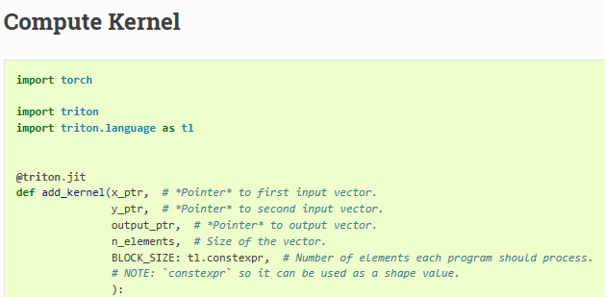
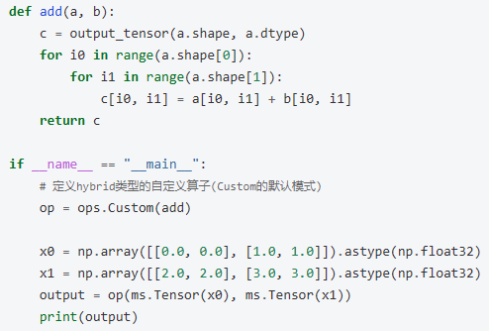
problem
torch.Tensor API
Vector addition example by Triton
JIT

Slide 3
JIT&AOT
AOT: AOT 编译是在程序运行之前将整个源代码或字节码文件一次性地编译成本地机器码。这意味着在程序运行时不需要再进行额外的编译工作，直接执行已经编译好的机器码。
JIT: JIT 编译是在程序运行过程中动态地将热点代码（频繁执行的代码）从字节码即时编译成本地机器码。JIT 编译器会根据实际的执行情况来选择需要编译的代码，并且可以根据优化策略对代码进行优化。

Slide 4
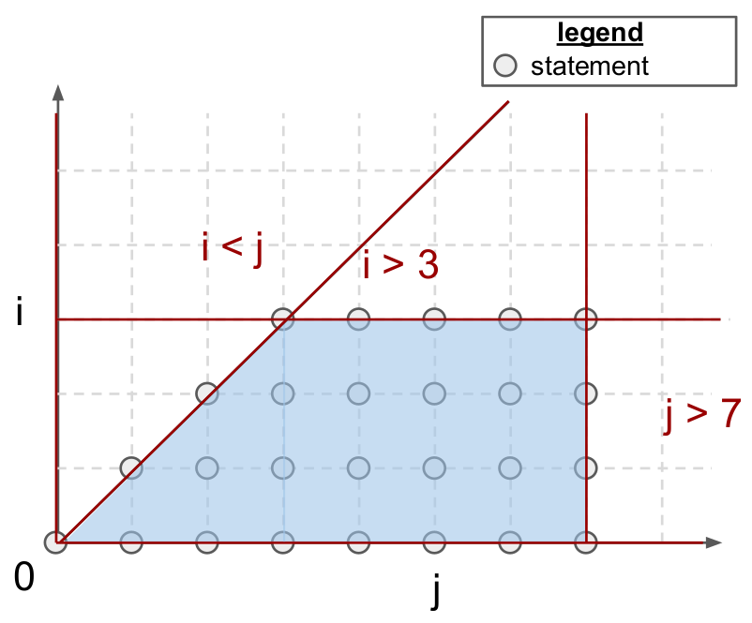
Polyhedral Model
optimize loops
for(int i = 0; i < 3; i++)
for(int j = i; j < 5; j++)
A[i][j] = 0;

Slide 5
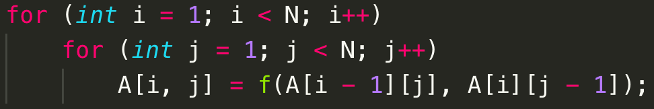
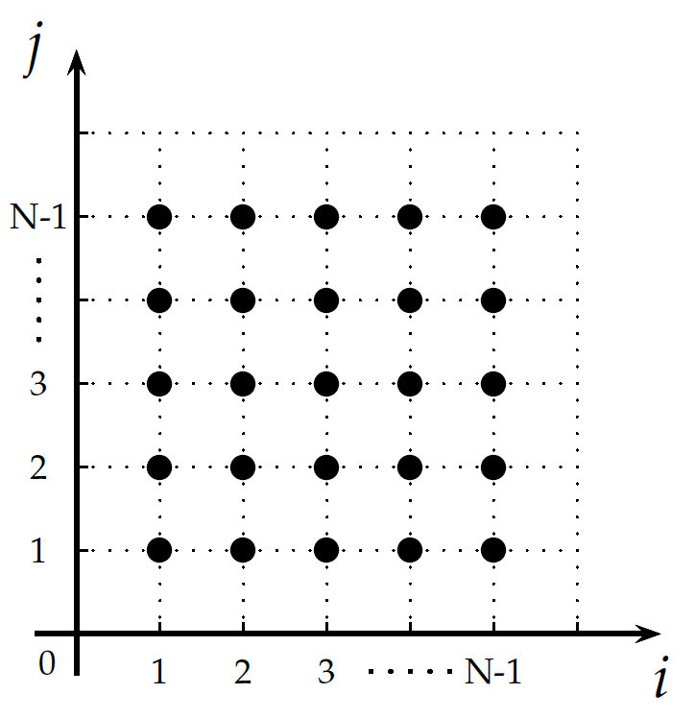
Polyhedral Model
{S[i, j] : 1 <= i <= N - 1 and 1 <= j <= N – 1}
Dependency:
{ S[i, j] -> A[i - 1, j] : 1 <= i <= N -1 and 1 <= j <= N- 1;
S[i, j] -> A[i, j - 1] : 1 <= i <= N - 1 and 1 <= j <= N -1 }

Slide 6
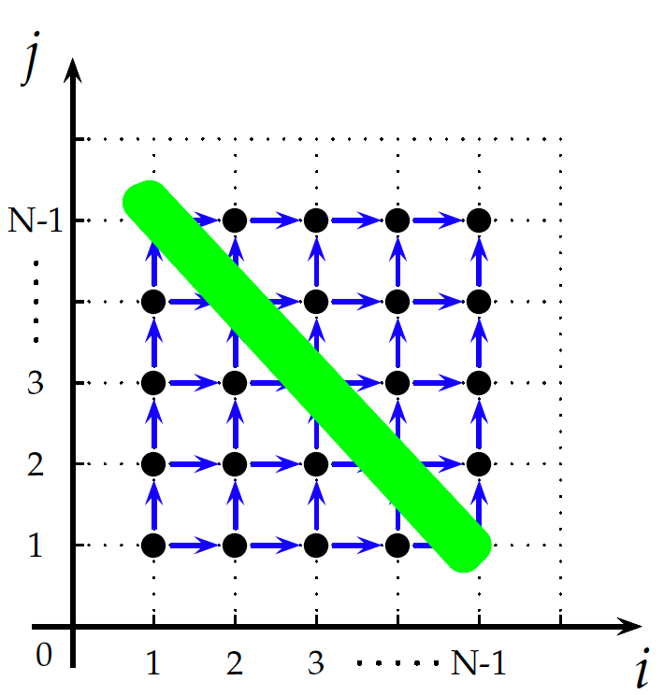
Polyhedral Model
{S[i, j] : 1 <= i <= N - 1 and 1 <= j <= N – 1}
Dependency:
{ S[i, j] -> A[i - 1, j] : 1 <= i <= N -1 and 1 <= j <= N- 1;
S[i, j] -> A[i, j - 1] : 1 <= i <= N - 1 and 1 <= j <= N -1 }
{ S[i, j] -> S[i, 1 + j] : 1 <= i <= N - 1 and 1 <= j <=N - 2;
S[i, j] -> S[i + 1, j] : 1 <= i <= N - 2 and 1 <= j <= N- 1 }
仿射变换变基：
{ S[i, j] -> [i + j, j]}

Slide 7
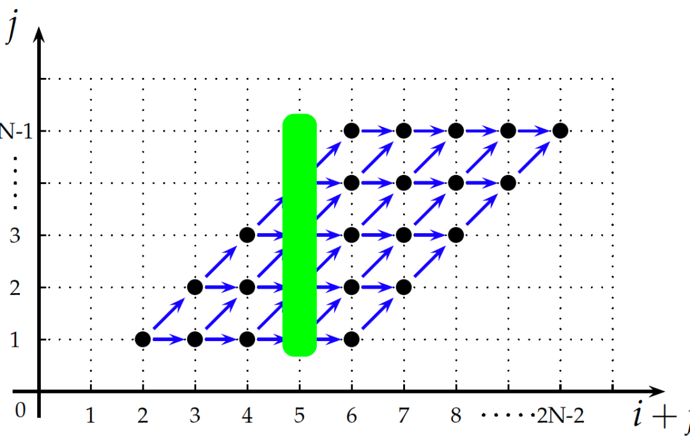
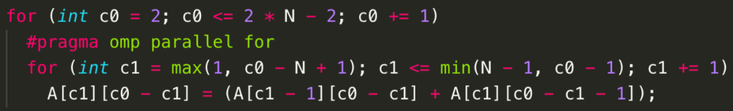
Polyhedral Model
{ S[i, j] -> S[i, 1 + j] : 1 <= i <= N - 1 and 1 <= j <=N - 2;
S[i, j] -> S[i + 1, j] : 1 <= i <= N - 2 and 1 <= j <= N- 1 }
仿射变换变基：
{ S[i, j] -> [i + j, j]}

Slide 8
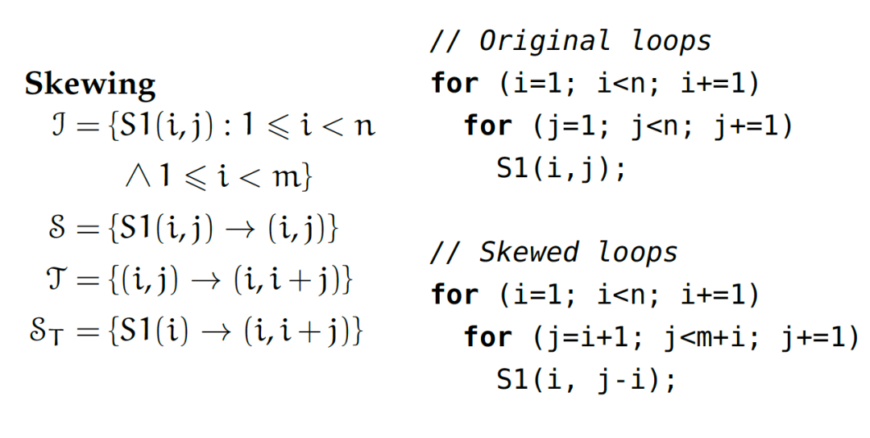
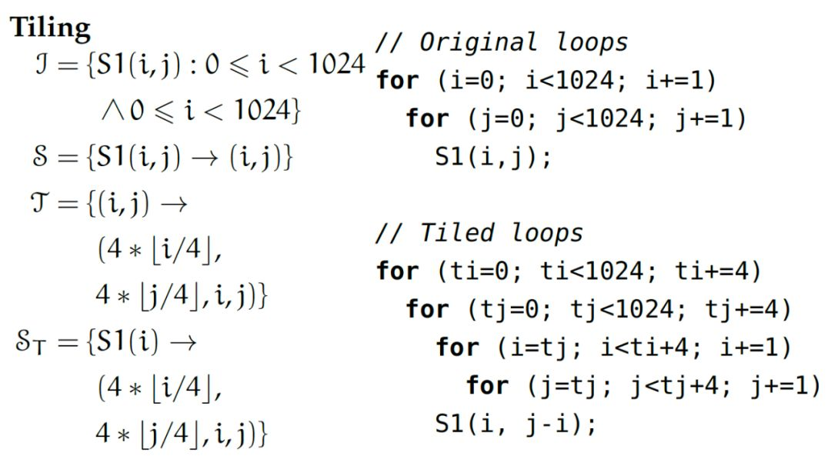
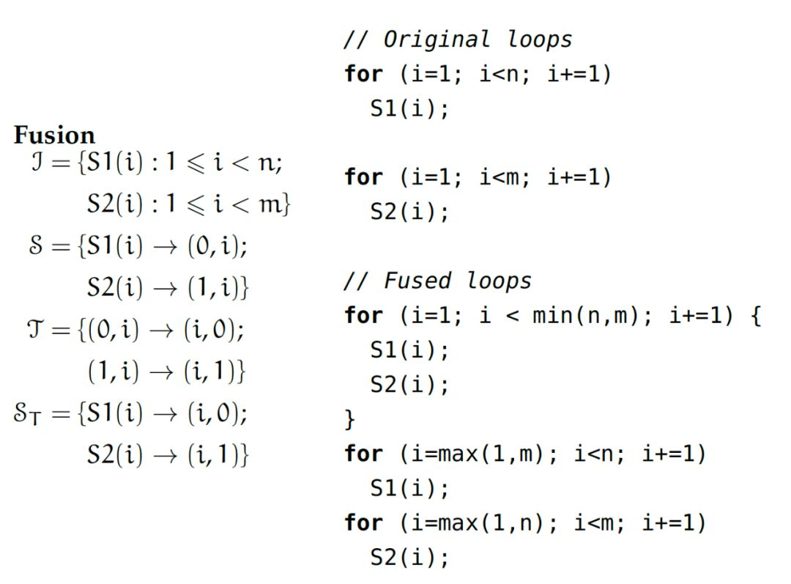
Polyhedral Model

Slide 9
Polyhedral Model
Advantages
promote parallelism and spatial/temporal data locality
Polyhedral compilers can also automatically go through complex verification processes to ensure that the semantics of their input program is preserved throughout this optimization phase.
it is also fully automatic and doesn’t require any hint from programmers apart from source-code in a C-like format.
Limitations in Triton
the set of possible program transformations is large, and grows with the number of statements in the program as well as with the size of their iteration domain.
the polyhedral framework is not very generally applicable; SCoPs(Static Control Parts) are relatively common but require loop bounds and array subscripts to be affine functions of loop indices, this framework still has to be successfully applied to sparse – or even structured-sparse – neural networks.

Slide 10
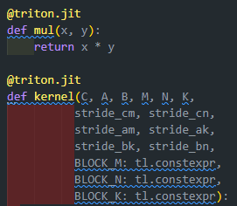
To be solved
def _attn_fwd_inner
def _attn_fwd
def _attn_bwd_preprocess
……
Why the two function must be separated into two file to compile?
How to build a file with multiple kernels?

Slide 11


